Slide 1

CLASS 14 :Event Handling

Slide 2
Introduction: What are Events?
Definition: Events are actions or occurrences that happen in the browser that JavaScript can respond to. They make web pages interactive and dynamic.
Common Events:
Mouse Events: click, mouseover, mouseout, mousemove
Keyboard Events: keydown, keyup, keypress
Form Events: submit, change, input, focus, blur
Window Events: load, resize, scroll
Why Event Handling Matters;
Creates interactive user experiences
Responds to user input in real-time
Makes web applications feel responsive and alive

Slide 3
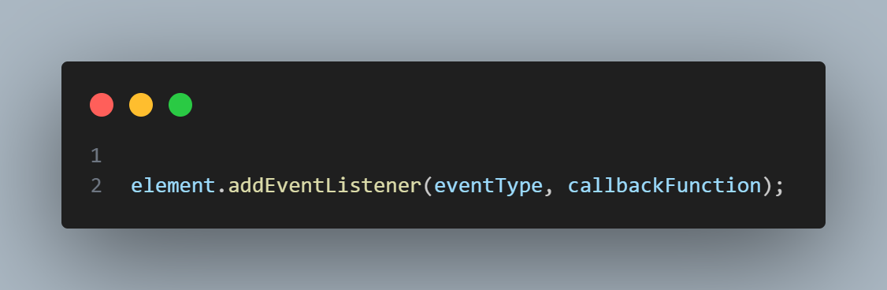
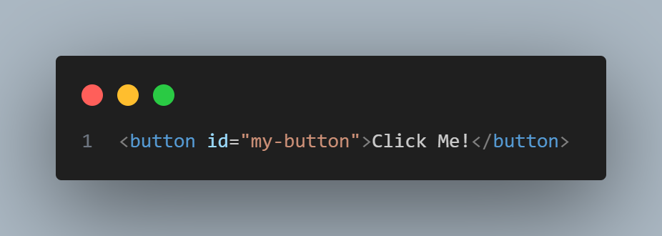
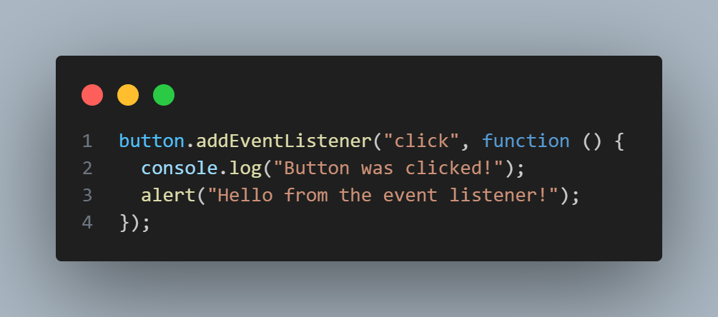
Part 1: Adding Event Listeners
The ‘addEventListener’ Method
The modern way to handle events in JavaScript.

Slide 4
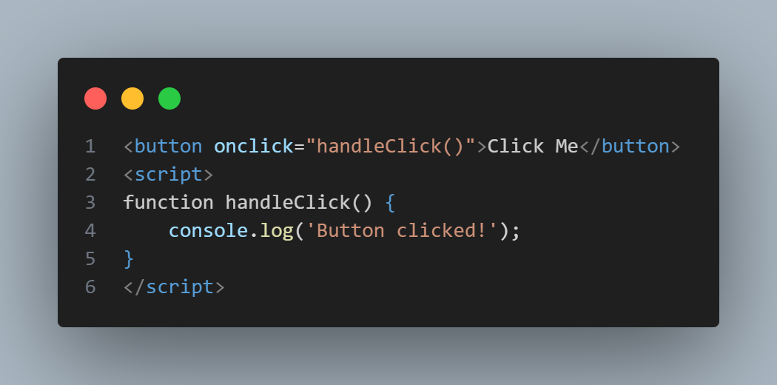
Part 1 cont’d
Different Ways to Add Event Listeners
Method 1: Inline HTML (Not Recommended)

Slide 5
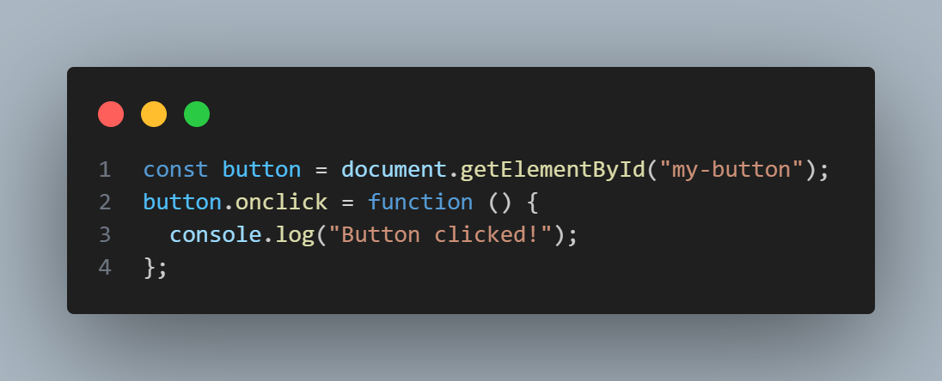
Part 1 cont’d
Method 2: DOM Property (Limited)

Slide 6
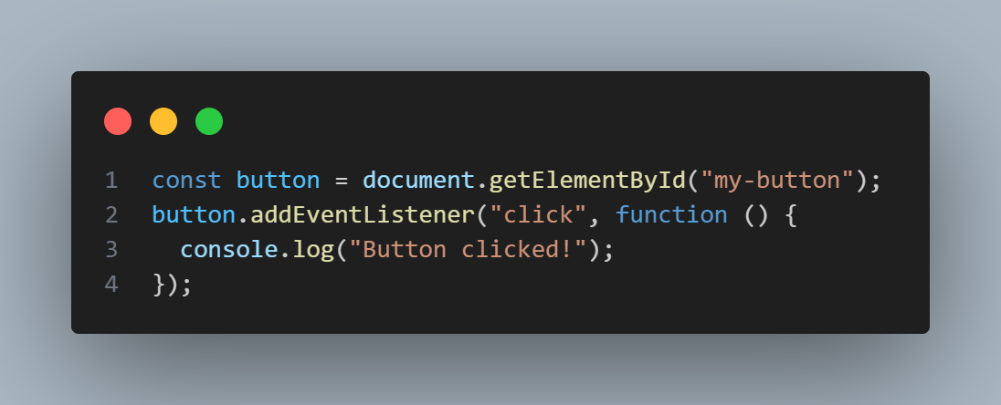
Part 1 cont’d
Method 3: addEventListener (Recommended)

Slide 7
Part 2 cont’d
Why addEventListener is Best:
Can add multiple listeners to same element
More control over event behavior
Better browser compatibility
Can use event capturing/bubbling

Slide 8
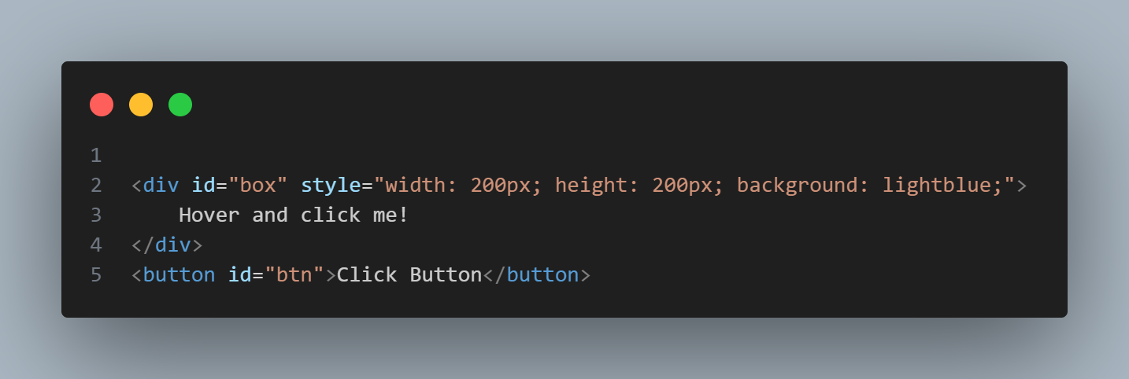
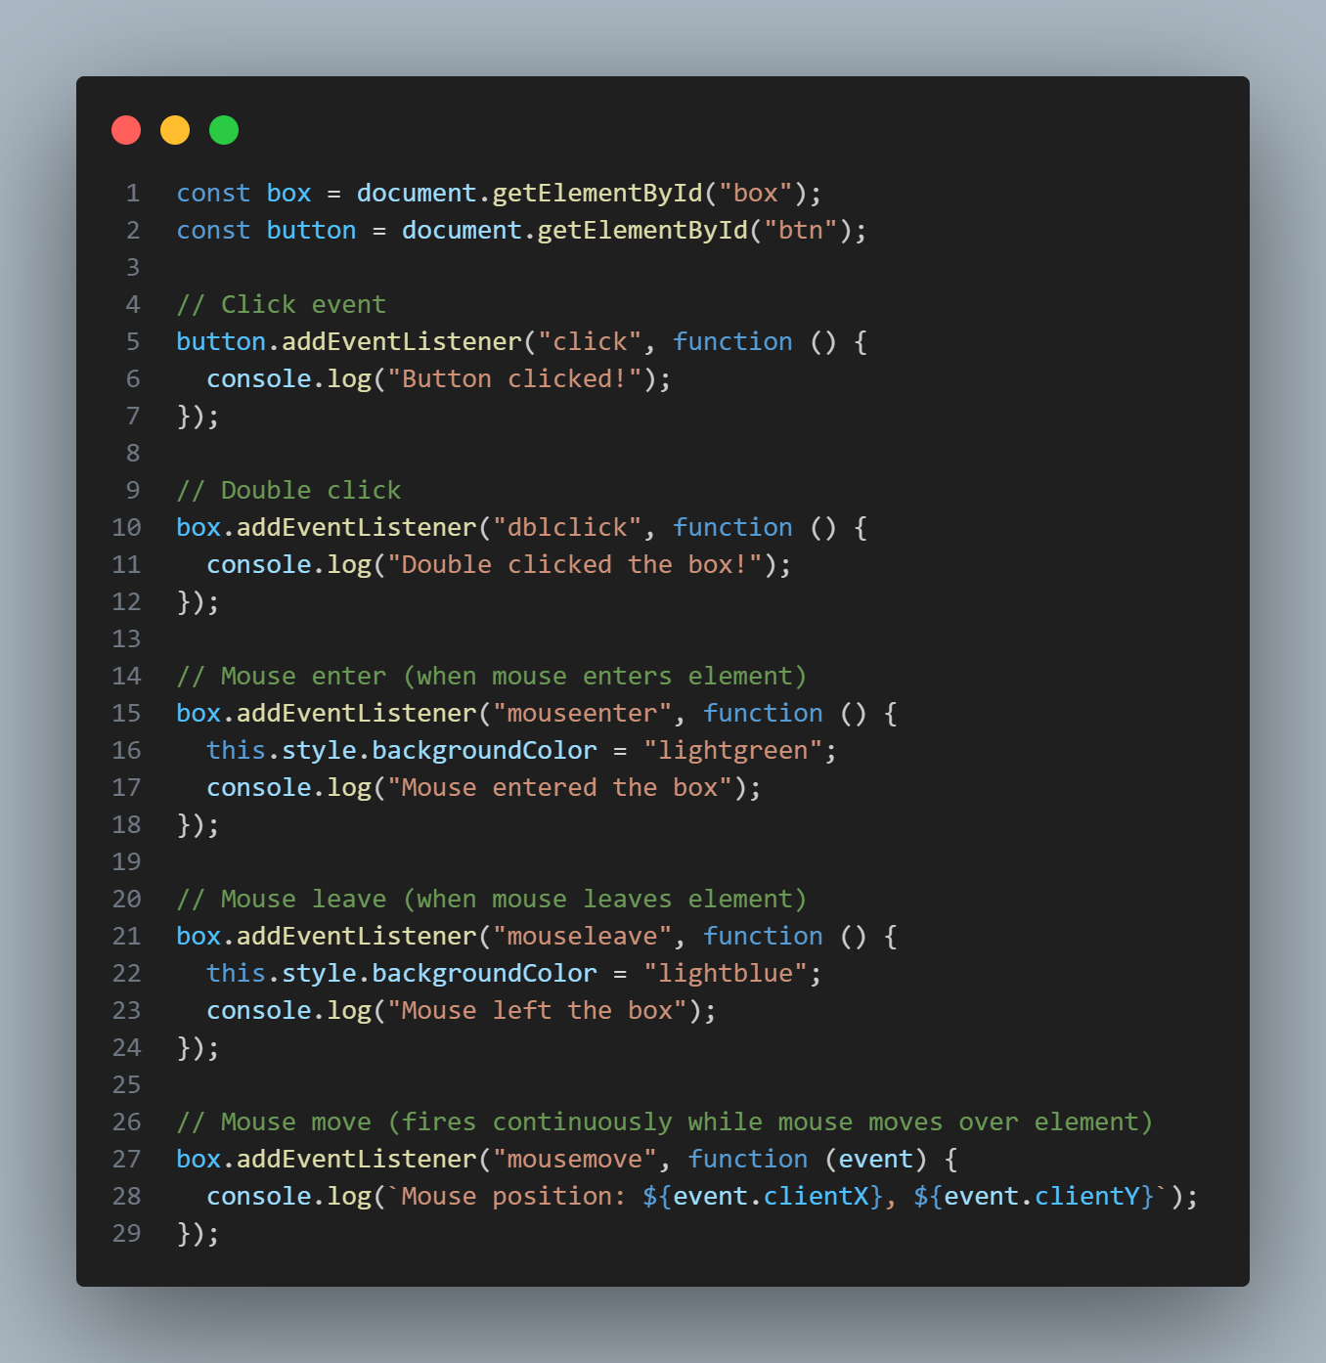
Examples

Slide 9
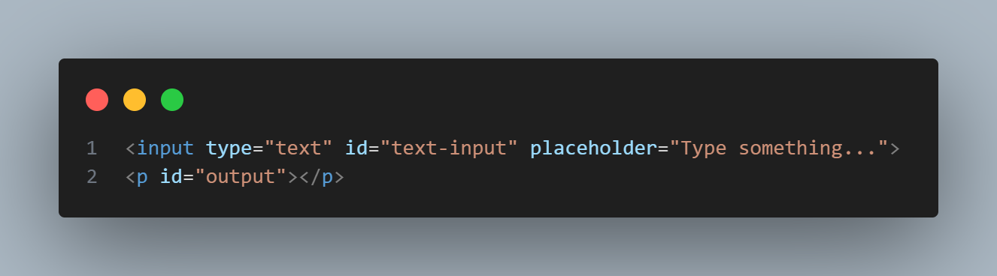
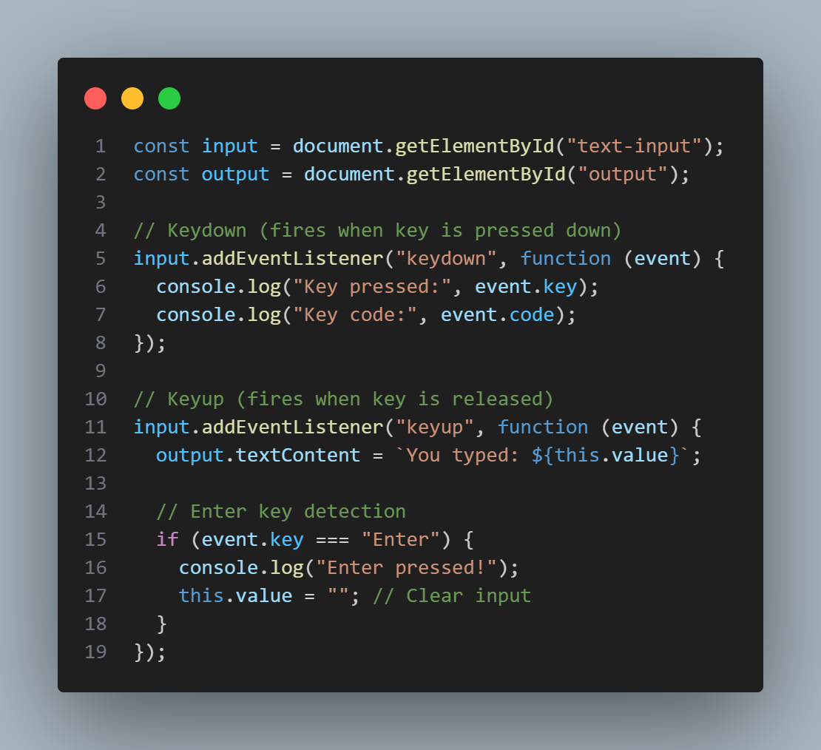
Part 2 cont’d
Keyboard Events

Slide 10
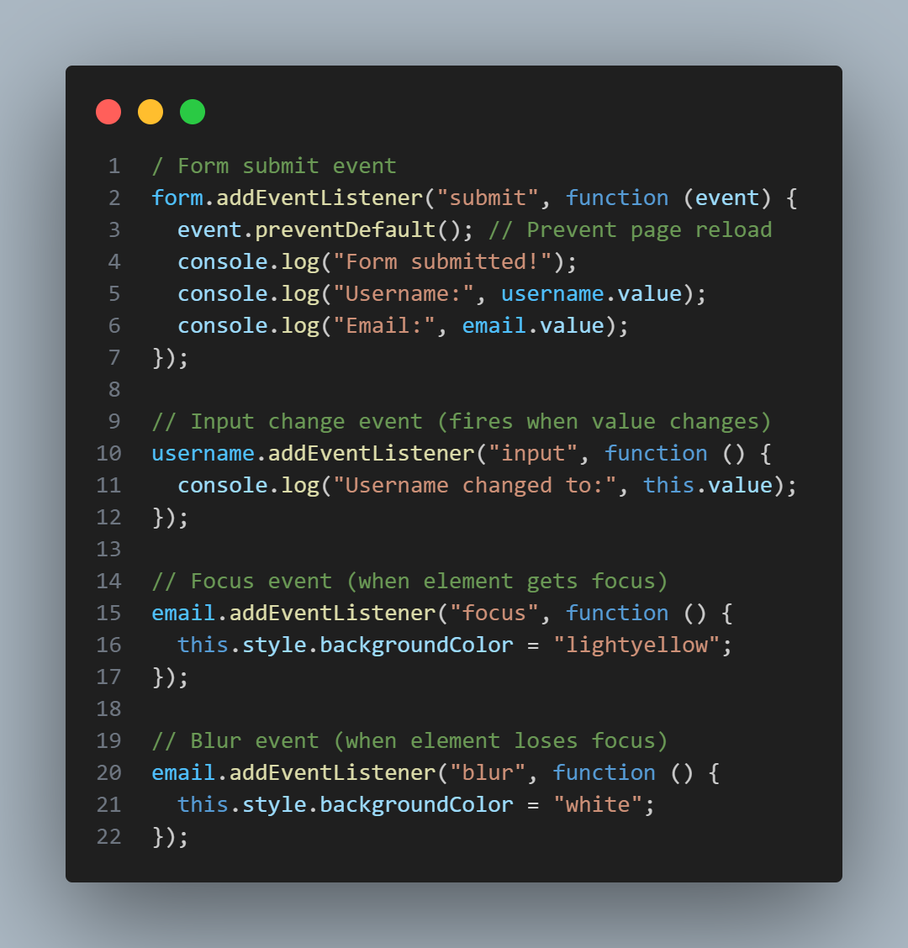
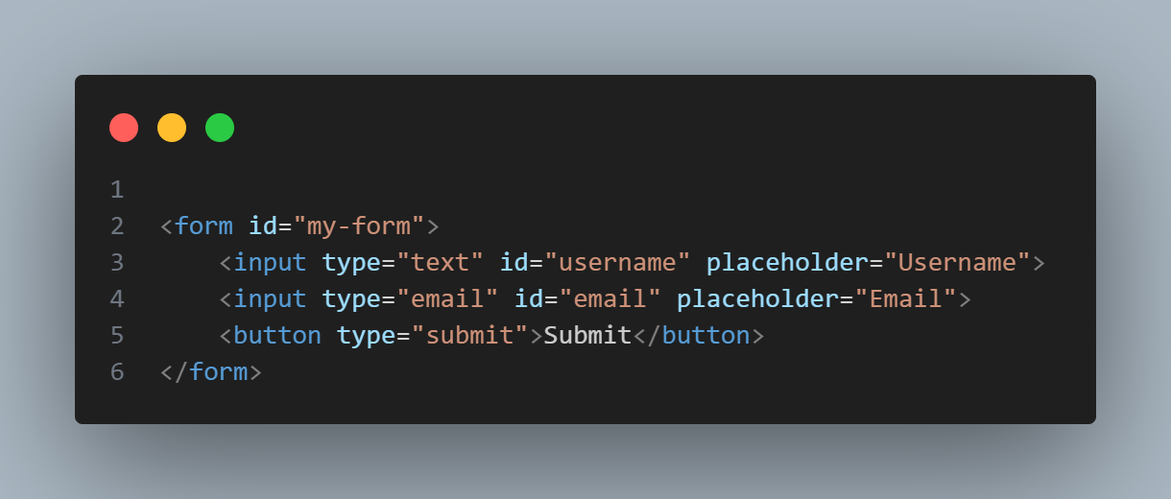
Part 2 cont’d
Form Events

Slide 11
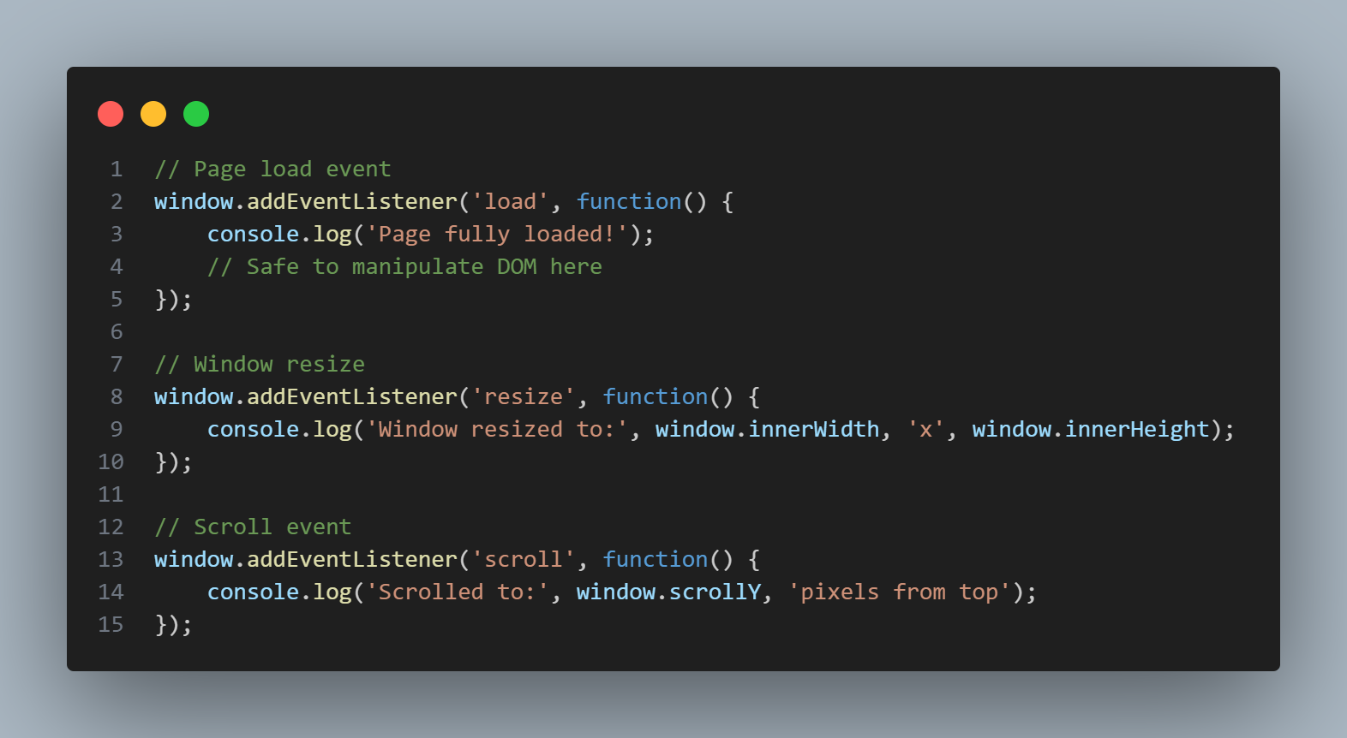
Part 2 cont’d
Window Events

Slide 12
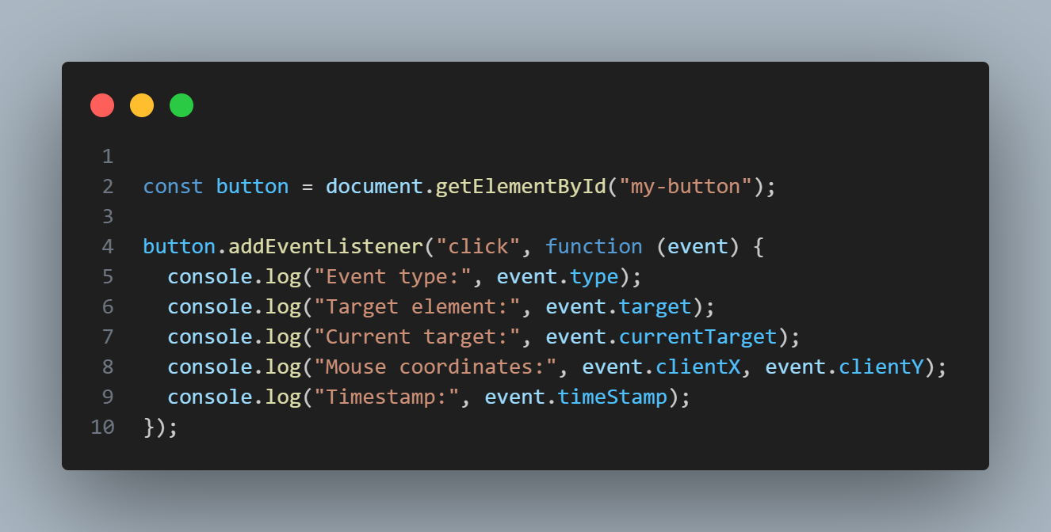
Part 3: The Event Object
Understanding the Event Object
When an event occurs, the browser creates an event object containing information about the event.

Slide 13
Part 4: Event Propagation (Bubbling and Capturing)
Understanding Event Flow
Events propagate through the DOM in three phases:
Capturing Phase: From window down to target
Target Phase: At the target element
Bubbling Phase: From target up to window

Slide 14
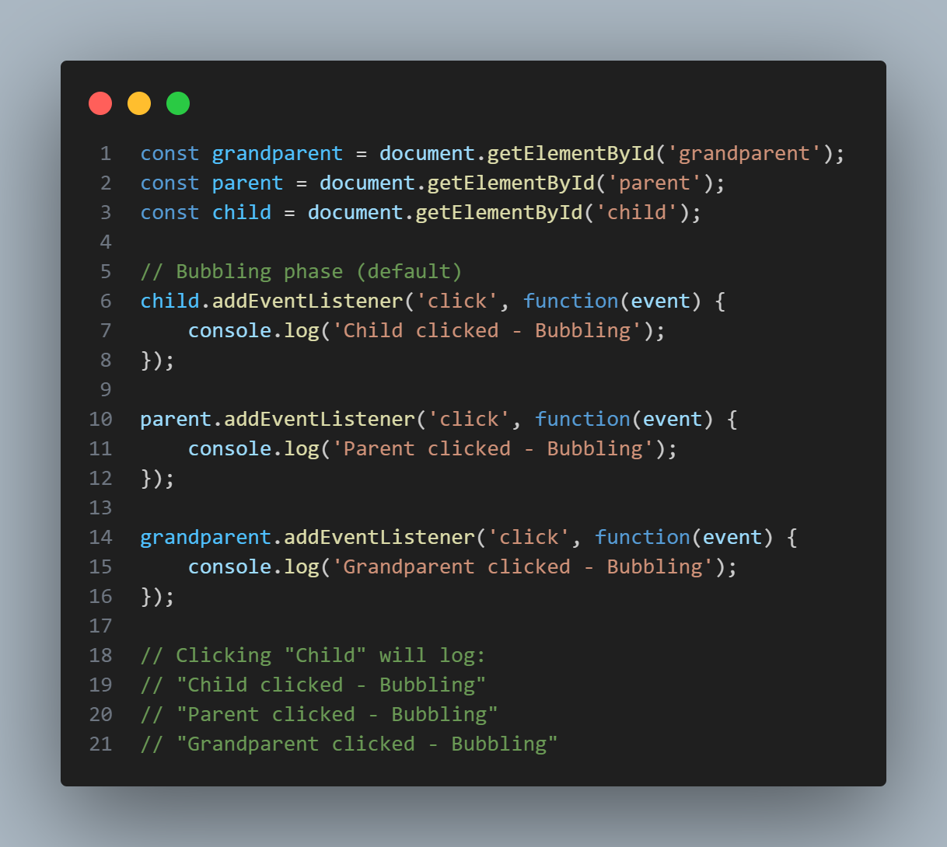
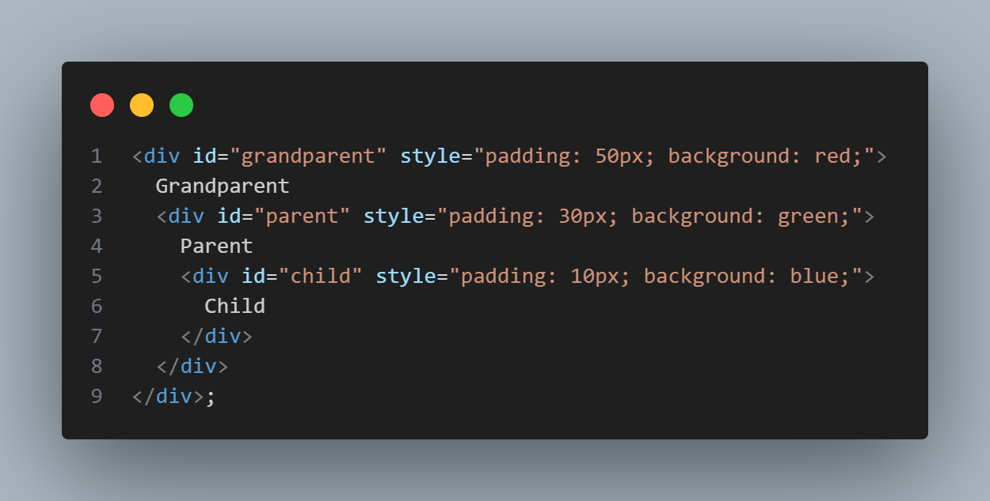
Part 4 cont’d

Slide 15
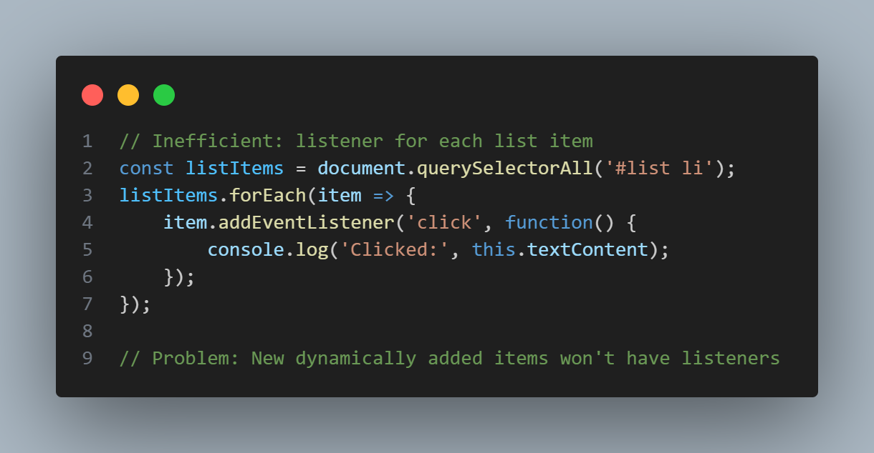
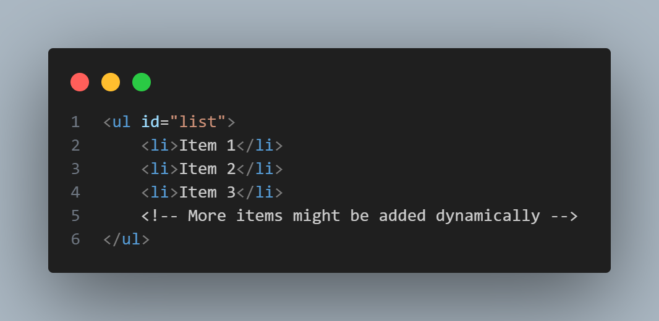
Part 5: Event Delegation
What is Event Delegation?
Instead of adding event listeners to each child element, add one listener to a parent element and use event bubbling to handle events.
Problem without delegation:

Slide 16
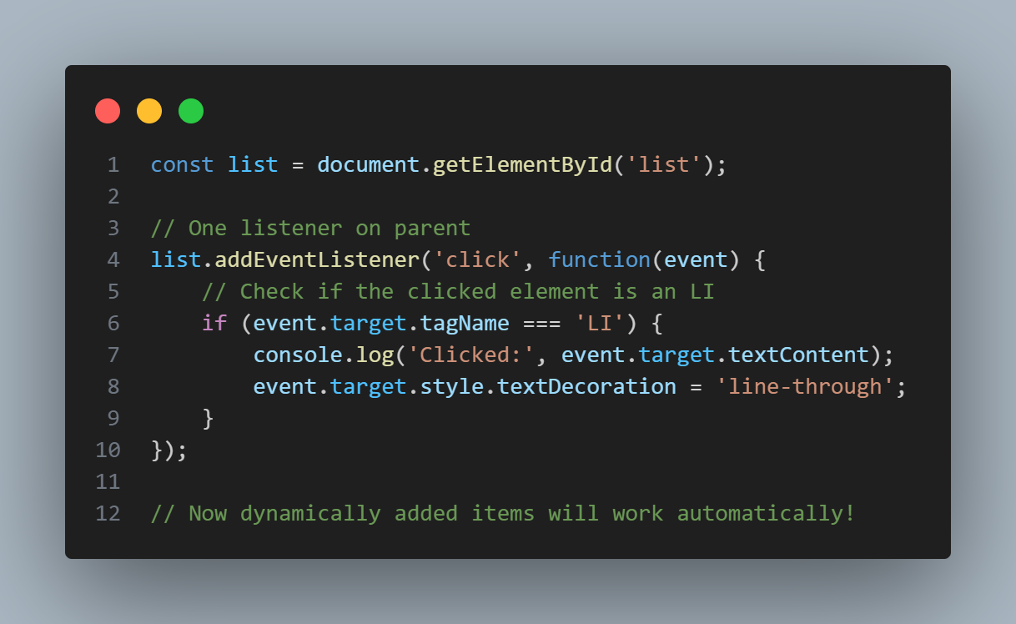
Part 5: Event Delegation
Solution with event delegation:

Slide 17
Part 5: Event Delegation
Benefits of Event Delegation:
- Performance: Fewer event listeners
- Dynamic Content: Works with elements added later
- Memory Efficiency: Less memory usage
- Cleaner Code: Centralized event handling

